Slide 1
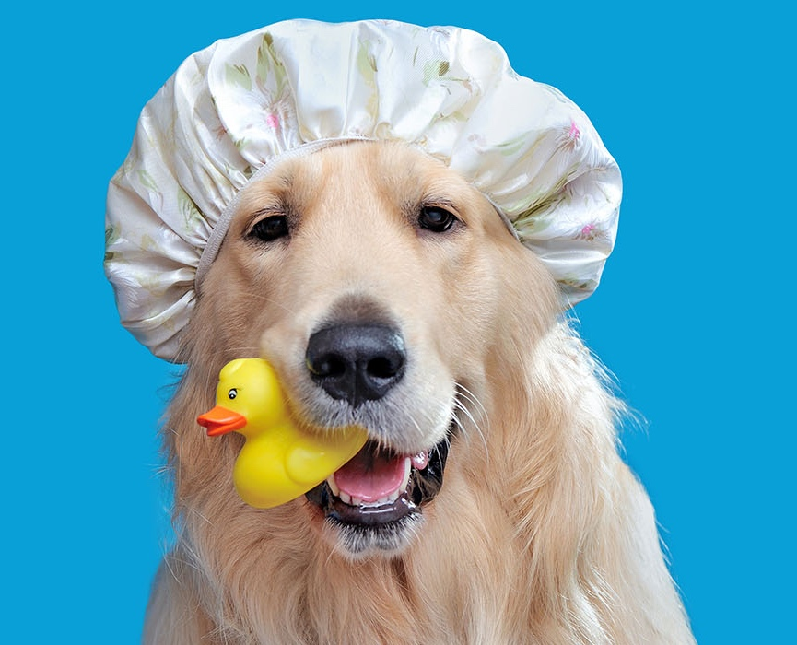
Activities of Daily Living
Washing up
Compiled by: Jessica M. Currall

Slide 2
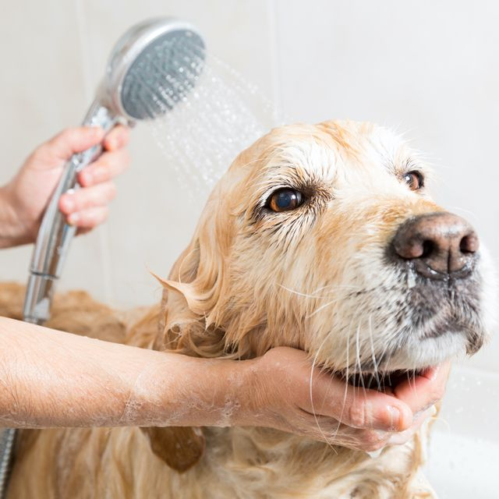
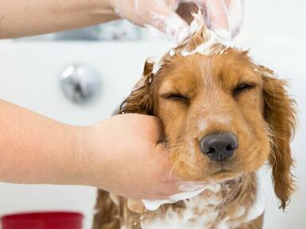
Soap is used for washing up.
Water rinses off bubbles.

Slide 3
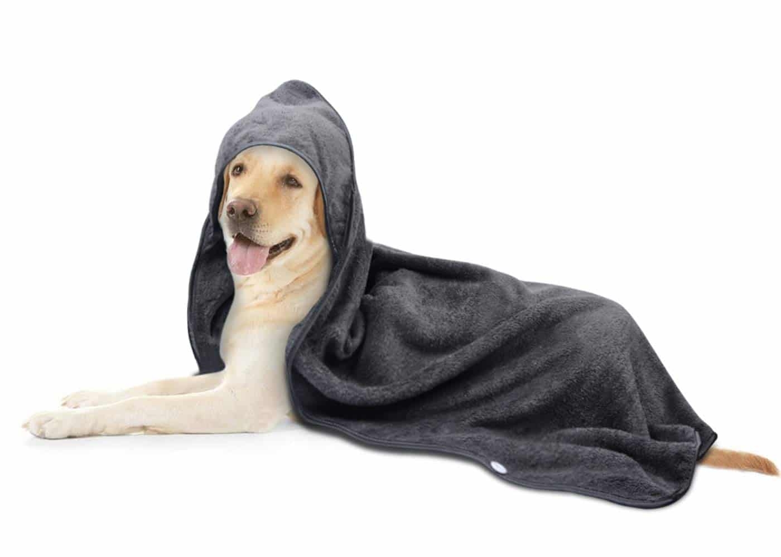
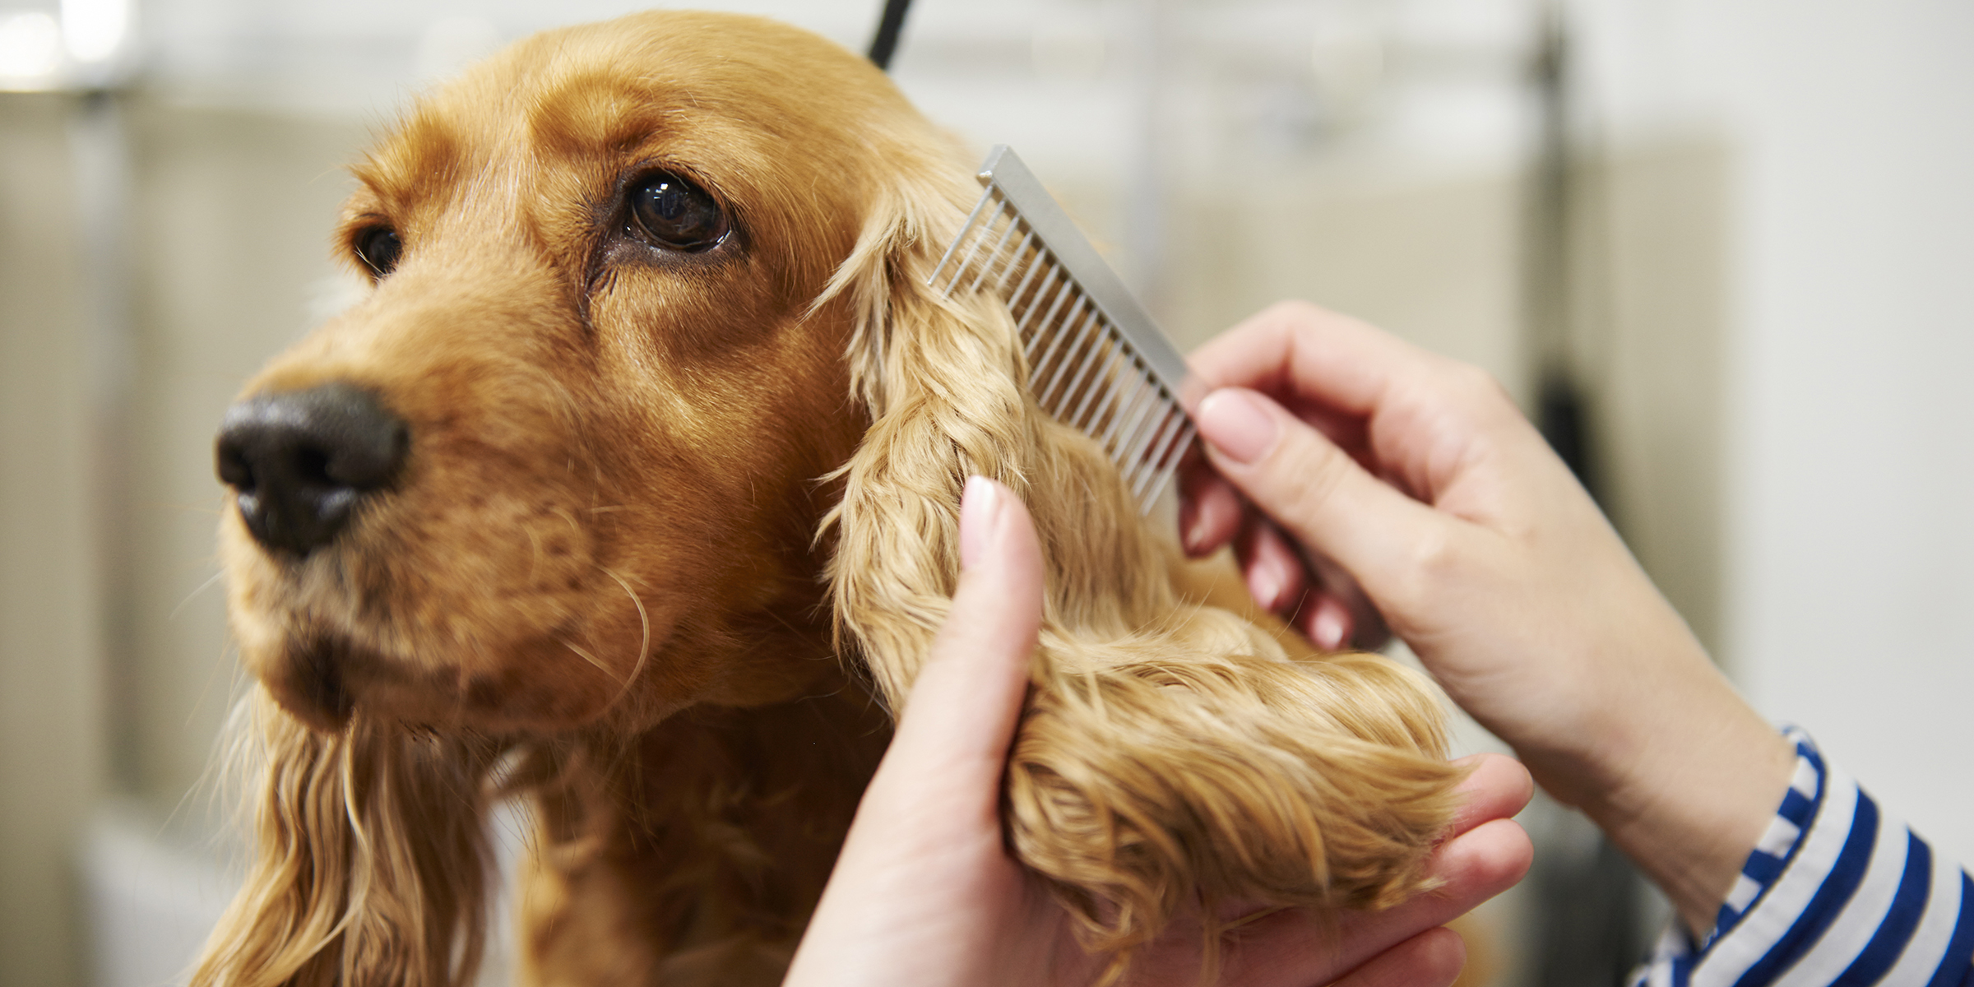
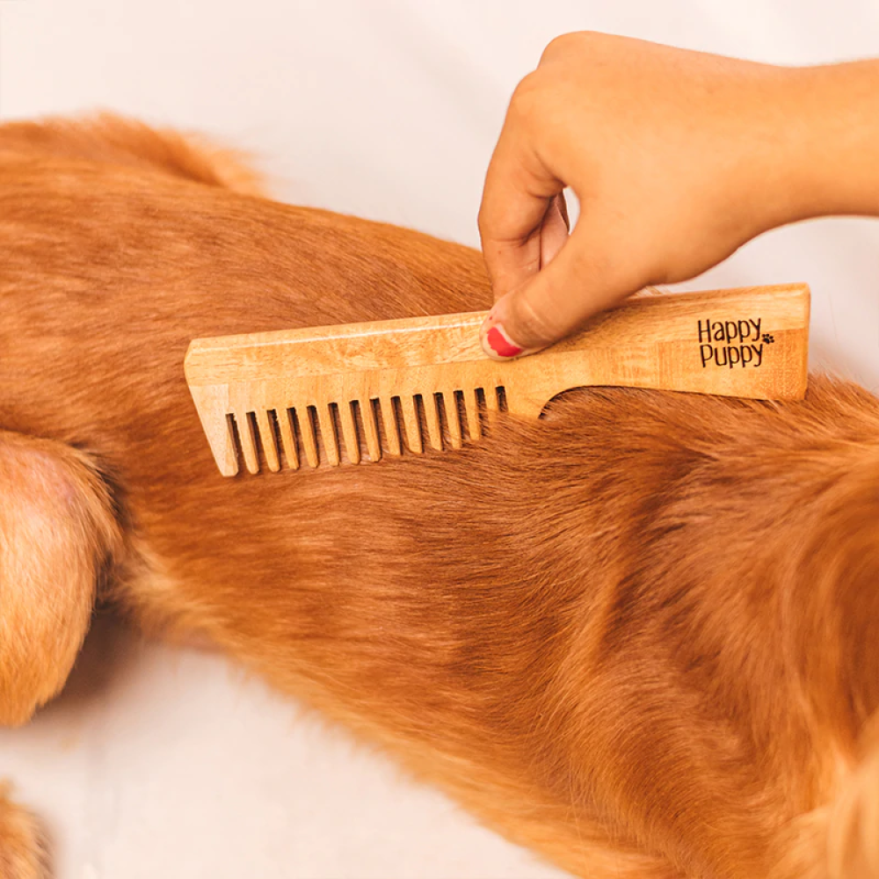
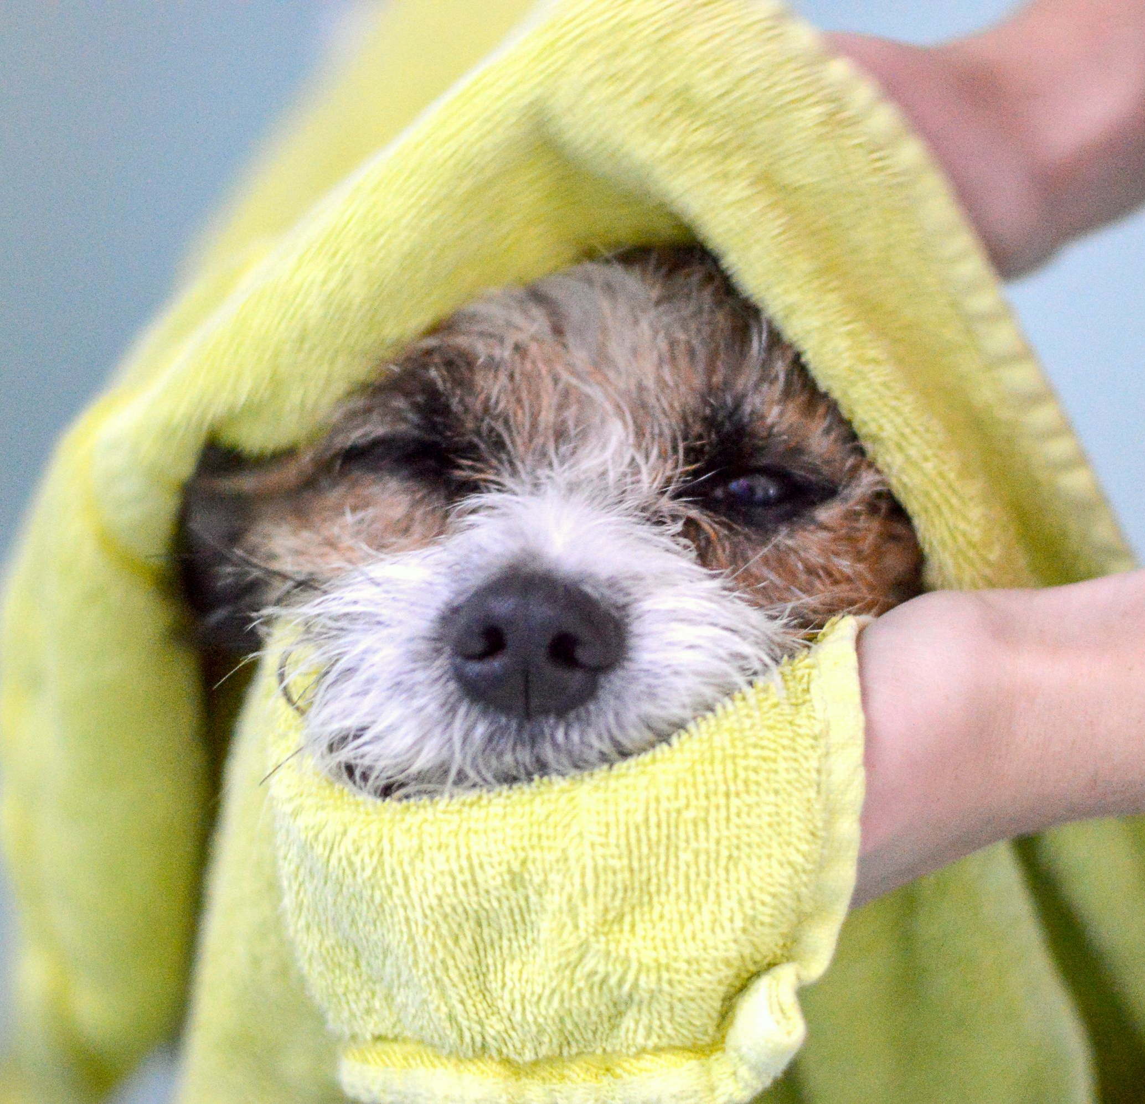
Dry off with a soft towel.
Hair can be combed.

Slide 4

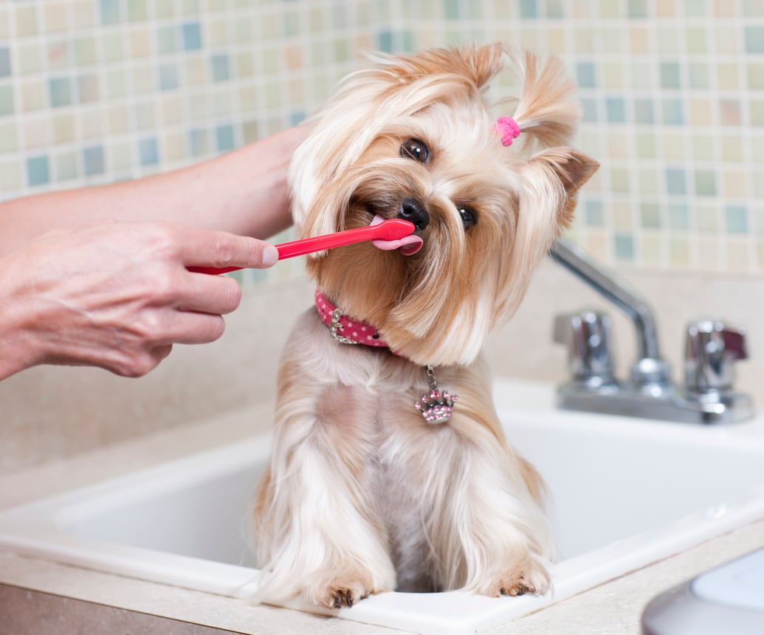
Special brushes are used to reach important parts.
Washing up is important.

